Slide 1
React
Module 20

Slide 2
What Is React?

Slide 3
React
React is:
One of the most powerful, in-demand front-end JavaScript libraries available today.
A JavaScript library that helps you create complex and responsive single-page applications.
Widely popular and well supported by the developer community.
Created by the developers at Facebook.
Makes code reusable and divides things into components.

Slide 4
What Problem Does React Solve?

Slide 5
What Problem Does React Solve?
React solves the following problems:
DOM operations are quite expensive in terms of performance, so React creates a virtual DOM (VDOM).
The VDOM is a representation of the page structure in memory. It tracks what needs to be updated and only updates those specific things.
React is not opinionated like many other frameworks. It gives the developer the freedom to use Javascript the way they want to use it.

Slide 6
Can You Give Me an Example?

Slide 7
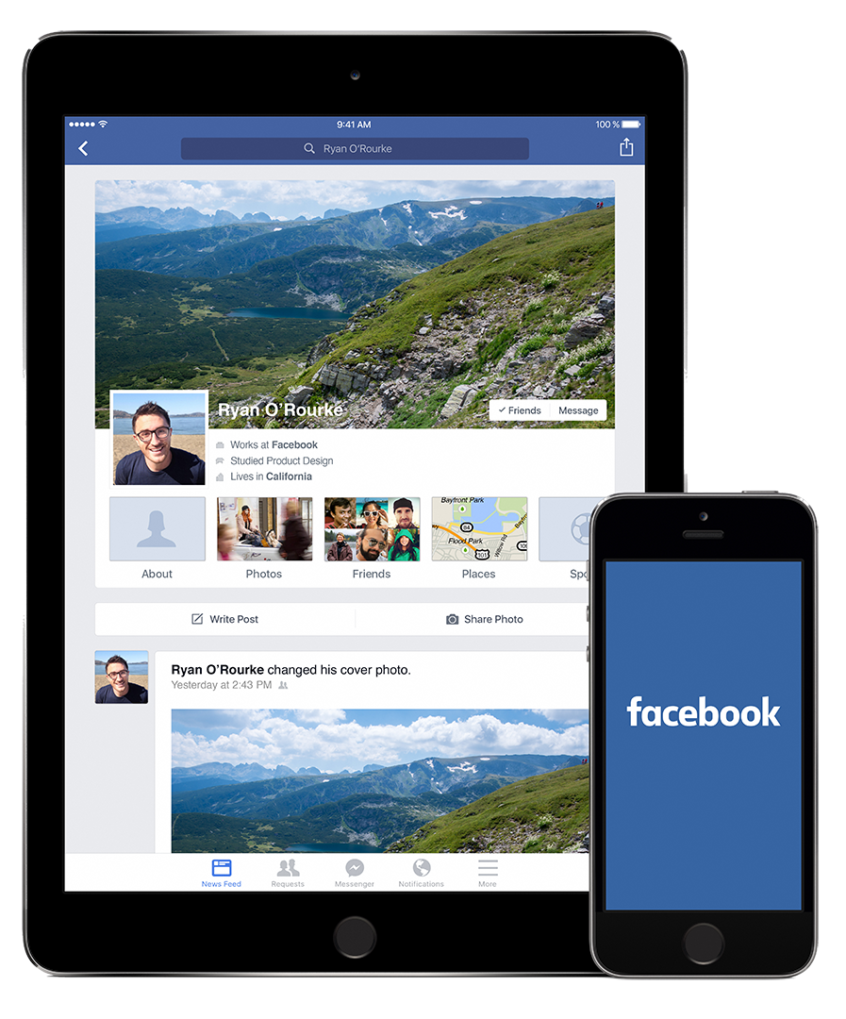
React Example: Facebook
Facebook’s UI is a great example of React in action.
Each section of the page is a component that itself has tons of real-time updates happening every second.
The component design pattern allows Facebook to add a search bar and messenger to nearly every page that the user visits.
Notes:
shutterstock_296505179.png

Slide 8
Facebook uses multiple components with interactive options, live-updating data, and tightly interacting elements. This poses a challenge to a simple DOM.

Slide 9
What Are Props?

Slide 10
React Props
Props are:
Props are a specialized type of parameter passed into a React component that help define attributes in the user interface, similar to DOM attributes.
Props allow data to be passed from a parent component to a child component.
Props is short for properties and refers to a normal JavaScript object that contains key-value pairs.

Slide 11
Why Separate UI Components?

Slide 12
Why Separate UI Components?
Logically decompose a UI into unique parts.
Easily reuse these parts without rewriting code.
Separate components are easier to test.
Helps isolate bugs, saving time.

Slide 13
How Is This Different Than Regular DOM Manipulation?

Slide 14
How Is This Different Than Regular DOM Manipulation?
In JavaScript, the application’s state and UI are updated independently of each other.
With React, whenever the application’s state changes, the DOM updates to reflect it.
With React, the UI is a pure function of the application’s state.

Slide 15
How Do We Handle Constant Data Changes?

Slide 16
Rapid Data Changes in Plain Vanilla Javascript
JavaScript is fast, but whenever we update the DOM, the browser needs to recalculate the CSS, update the layout, and repaint the webpage. This can be a slow process.
Data-Driven Events
DOM
Article comments
Users signed On
Weather forecast
News feed articles
Messages sent

Slide 17
Rapid Data Changes in React
React’s virtual DOM serves as an intermediary and avoids unnecessary trips to the DOM.
Data-Driven Events
DOM
Article comments
Users signed On
Weather forecast
Newsfeed articles
Messages sent
Virtual DOM

Slide 18
What Is the Virtual DOM?

Slide 19
The virtual DOM is an ideal representation of the user interface kept in memory. It is "synced" with the actual DOM through a process called reconciliation.

Slide 20

What Is the Virtual DOM?
01
02
We tell React what state the UI ought to be in, and React ensures that the DOM matches the internal state.
DOM matches the internal state. We isolate the attribute changes, event handling, and other DOM manipulation that we would otherwise use when building an app.

Slide 21
Can We Get a Visualization, Please?

Slide 22
Document Object Model (DOM)
A virtual DOM is a JavaScript object that models the real DOM.
Real DOM
Diff
Patch
In-memory DOM
DOM

Slide 23
Document Object Model (DOM)
Whenever some part of the application’s state changes, the virtual DOM receives the UI updates first.
Real DOM
Diff
Patch
In-memory DOM
DOM

Slide 24
Document Object Model (DOM)
Then the virtual DOM is compared to the real DOM.
Real DOM
Diff
Patch
In-memory DOM
DOM

Slide 25

Document Object Model (DOM)
React then updates with the smallest number of changes.
Real DOM
Diff
Patch
In-memory DOM
DOM

Slide 26
What Are the Pros and Cons?

Slide 27


React Pros and Cons
Pros
Reusable components
UI updates in response to state change, reducing DOM manipulation code needed.
Can build applications on web, server, and native applications.
Easier to learn and more popular than other front-end JavaScript libraries and frameworks.
Cons
React is a view library concerned with rendering user interfaces. You have to pull in other libraries to accomplish things like HTTP requests.
Can require more configuration than other libraries.
1
1
2
3
2
4

Slide 28
What Tooling Is Needed?

Slide 29



React Tooling

Slide 30
What Is Webpack?

Slide 31
Webpack lets you modularize front-end code the same way you do in Node with CommonJS modules (require, module.exports). Webpack also lets you apply various transformations on your assets via plugins.

Slide 32
What Is Babel?

Slide 33
Babel Is a JavaScript Compiler. Babel lets you transpile next-generation JavaScript (ES6, ES7, ES8) into ES5 JavaScript that most browsers understand.

Slide 34
How Do We Learn React?

Slide 35
React was designed to help create performant single-page applications, but learning it can be daunting at first. Don’t worry—we will break it down into small digestible topics and take things one step at a time.

Slide 36
How to Learn React
You can try the following strategies to learn React:
Read the official documentation and practice with the provided examples.
Reverse-engineer finished code to see how something was accomplished.
Build something from scratch.
Debug a broken React app.
And most importantly, ask questions!

Slide 37
Mini-Project

